Slide 1
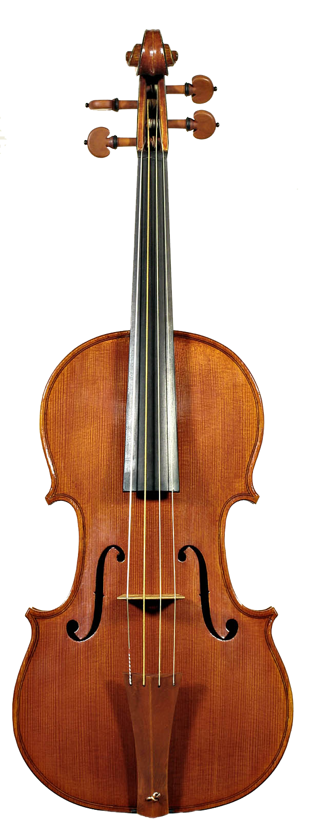
Vibrato

Slide 2

Vibrato simulation
Small, quasi-periodic variations in pitch of tone
Typical vibrato depth is on order of 1 percent
One semitone = variation
Often accompanied by tremolo
Amplitude modulation at same frequency as vibrato
To apply vibrato
Quasi-periodic frequency shift
Use a modulated delay line
Time-varying delay changes pitch of sound
Simulated Doppler shift

Slide 3
Vibrato in the acoustic world
Violin
Vibrato produced by wiggling finger
Changes where the string is stopped on the fingerboard
Vibrato frequency can be very slow
circa 6 Hz for example
Frequency modulations of string vibrations produce amplitude modulations
Due to complex frequency response of violin body
Singing voice
Vibrato produced by modulating tension of vocal folds

Slide 4

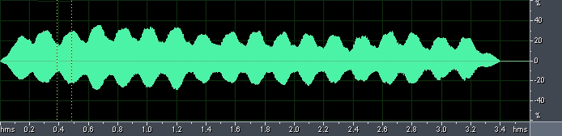
Examples
Single note (A#) with no vibrato
Same note, with vibrato
Without vibrato, with reverb
Vibrato and reverb

Slide 5


Digital implementation
Variable delay alone, no mix
Delay modulation yields vibrato when the modulation is sinusoidal
Reduced case of the flanger
Variation controlled by low-frequency oscillator
Interpolated (fractional) delay line is required
Typical values
M (average delay): 5-10ms
f = (LFO frequency): 5-14Hz
Basic vibrato
LFO
x[n]
y[n]
Modulated delay and pitch shift
Delay M[N]

Slide 6
Effect of changing delay
How do frequencies in a signal change with a changing delay?
Suppose the delay is constant
So output samples are still one sampling period apart
Suppose delay always increasing
Output samples are 0.9 times the sampling period apart
Less samples (so less time) for one cycle of a sinusoid.
So increasing delay gives longer period / lower frequency / pitch shift down
… Decreasing delay gives shorter period / higher frequency / pitch shift up
Generalises to pitch shift given by
For
Now consider vibrato

Slide 7


Determining vibrato width
Width (max frequency deviation) of vibrato depends on LFO frequency and sweep width:
Consider average delay M, sweep width W, frequency f
Total delay
Derivative of delay is difference in speed between read and write pointers:
Like difference
Write pointer always moves at constant speed
1 sample written per input sample
Speed of the read pointer determines pitch shift:
Example for one semitone vibrato (1.059), f = 5Hz:

Slide 8
Vibrato in operation. LFO waveform and pitch shift
W=2ms, M=2ms, f_{LFO}= 2 Hz
W=2ms, M=2ms, f_{LFO}= 4 Hz
LFO waveform
Pitch shift

Slide 9



Other LFO waveforms
Sinusoidal LFO modulation is the most common
Resembles vibrato in the physical/acoustic world
What if we used a triangle wave LFO?
1.0

Slide 10
Triangular and sawtooth LFOs, with corresponding pitch shift

Slide 11
Vibrato C++ code(1/2)
// Variables in this example whose values are set externally:
int numSamples; // Indicates how many audio samples to process
float *channelData; // Array of audio samples, length numSamples
float *delayData; // Our circular delay buffer of audio samples
int BufLength; // Length of our delay buffer in samples
int dpw; // Write pointer into the delay buffer
float ph; // Current phase of the LFO, always between 0-1
float inverseSampleRate; // 1/f_s, where f_s is sampling frequency
// User-adjustable effect parameters:
float frequency_; // Frequency of the low-frequency oscillator
float sweepWidth_; // Width of the LFO in samples

Slide 12
Vibrato C++ code(2/2)
for (i = 0; i < numSamples; ++i)
{
in = channelData[i];
// Recalculate read pointer position with respect to write pointer.
currentDelay = sweepWidth_*(1 + sinf(2 * M_PI * ph))/2;
//Subtract 3 samples to delay pointer so enough written samples to interpolate
dpr= fmodf(dpw-currentDelay*getSampleRate())+BufLength-3, BufLength);
// Interpolate fractional value from where read pointer sits between two samples
fraction = dpr - floorf(dpr);
prevSample = (int)floorf(dpr);
nextSample = (prevSample + 1) % BufLength;
interpSample=fraction*delayData[nextSample]+(1-fraction)*delayData[prevSample];
delayData[dpw] = in; // Store current information in delay buffer
//Increment write pointer at constant rate. Read pointer moves at different
// rates depending on settings of LFO, the delay and sweep width.
if (++dpw >= BufLength) dpw = 0;
// Store output sample in buffer, replacing input. Delayed sample is only
//component of output (no mixing with dry signal)
channelData[i] = interpSample;
ph += frequency_*inverseSampleRate; // Update LFO phase, keeping it in range 0-1
if(ph >= 1.0) ph -= 1.0;
}

Slide 13
Vibrato code
Our Vibrato effect will be simple VST plugin
Start with Delay plugin
Add methods for LFO and interpolation
In processBlock
Outer loop is samples, inner loop is channels
→ So only increment pointer once for each sample

Slide 14
Define and initialise
Start with Delay plugin
Change private parameters to pluginProcessor.h
float getLfoSample(float phase, int waveform);
float interpolateSample(int type, float delayReadPosition,
float* delayData, int delayBufferLength);
void parameterChanged();
juce::AudioParameterFloat* lfoFrequencyParam;
juce::AudioParameterFloat* sweepWidthParam;
juce::AudioParameterChoice* lfoTypeParam;
juce::AudioParameterChoice* interpolationTypeParam;
float lfoPhase; // Phase of the low-frequency oscillator
float interpolatedSample;
juce::AudioSampleBuffer delayBuffer;
int delayBufferLength;
int delayWritePosition = 0;
float delayReadPosition = 0;
Parameters on interface
Circular buffer variables for implementing delay
Notes:
MidiKeyboardComponent needs a MidiKeyboardState and the orientation as arguments.

Slide 15
Set up interface
In pluginProcessor.cpp
VibratoAudioProcessor::VibratoAudioProcessor()
…
{
addParameter(lfoFrequencyParam = new juce::AudioParameterFloat(
"lfoFrequency", "LFO frequency",0.1f,5.0f, 1.0f));
addParameter(sweepWidthParam = new juce::AudioParameterFloat(
"sweepWidth", "Sweep width", 0.001f, 0.05f, 0.01f));
addParameter(lfoTypeParam = new juce::AudioParameterChoice(
"lfoType", "LFO Type", { "triangle", "square", "sloped square", "sine" }, 1));
addParameter(interpolationTypeParam = new juce::AudioParameterChoice(
"interpolationType", "Interpolation Type",
{ "Nearest neighbour", "Linear", "Quadratic","Cubic" }, 1));
}
Notes:
MidiKeyboardComponent needs a MidiKeyboardState and the orientation as arguments.

Slide 16
Define and initialise
Set up delay buffer in prepareToPlay on pluginProcessor.cpp
Allocate and zero the delay buffer
size will depend on current sample rate)
Add 3 extra samples to allow cubic interpolation even at maximum delay
Add 3 extra samples to allow cubic interpolation even at maximum delay
void VibratoAudioProcessor::prepareToPlay (double sampleRate, int samplesPerBlock)
{
float sweepWidthMax = sweepWidthParam->getNormalisableRange().end;
delayBufferLength = (int)(sweepWidthMax * sampleRate) + 3;
delayBuffer.setSize(2, delayBufferLength);
delayBuffer.clear();
lfoPhase = 0.0f;
}
Allocate and zero the delay buffer (size will depend on current sample rate)
Notes:
MidiKeyboardComponent needs a MidiKeyboardState and the orientation as arguments.

Slide 17
The ProcessBlock
Set up the basics in the processBlock method on pluginProcessor.cpp
Information about these samples
const int numInputChannels = getTotalNumInputChannels();
const int numOutputChannels = getTotalNumOutputChannels();
const int numSamples = buffer.getNumSamples();
float sampleRate = (float)juce::AudioProcessor::getSampleRate();
auto lfoFrequency = lfoFrequencyParam->get();
auto sweepWidth = sweepWidthParam->get();
auto lfoType = lfoTypeParam->getIndex();
auto interpolationType = interpolationTypeParam->getIndex();
float currentDelay;
for (int i = 0; i < numSamples; ++i) {
currentDelay = sweepWidth * getLfoSample(lfoPhase, lfoType);
delayReadPosition = fmodf(float(delayWritePosition -
(currentDelay * getSampleRate()) + delayBufferLength - 3.0),
float(delayBufferLength));
for (int j = 0; j < numInputChannels; ++j) { … }
Working variable
Calculate read position from write position and delay
current delay from vibrato parameters & lfo phase
Notes:
/ Having made a local copy of the state variables for each channel, now transfer the result
// back to the main state variable so they will be preserved for the next call of processBlock()

Slide 18
The ProcessBlock
Iterate over samples
Read rate depends on LFO settings, delay & sweep width
current delay from vibrato parameters & lfo phase
Calculate read position from write position and delay
for (int i = 0; i < numSamples; ++i) {
currentDelay = sweepWidth * getLfoSample(lfoPhase, lfoType);
delayReadPosition = fmodf(float(delayWritePosition - (currentDelay * getSampleRate())
+ delayBufferLength - 3.0), float(delayBufferLength));
for (int j = 0; j < numInputChannels; ++j) { … }
if (++delayWritePosition >= delayBufferLength) delayWritePosition = 0;
lfoPhase += float(lfoFrequency / sampleRate);
while (lfoPhase >= 1.0f) lfoPhase -= 1.0f;
}
See next slide
Increment write pointer at constant rate
Update LFO phase, keeping it in range 0-1
Notes:
/ Having made a local copy of the state variables for each channel, now transfer the result
// back to the main state variable so they will be preserved for the next call of processBlock()

Slide 19
The ProcessBlock II – iterate over channels
Iterate over channels
Get one channel of a sample
for (int j = 0; j < numInputChannels; ++j) {
const float in = buffer.getWritePointer(j)[i];
float* delayData = delayBuffer.getWritePointer(j);
interpolatedSample = interpolateSample(interpolationType, delayReadPosition,
delayData, delayBufferLength);
delayData[delayWritePosition] = in;
buffer.getWritePointer(j)[i] = interpolatedSample;
}
delayData is circular buffer for implementing delay on this channel
Fractional delay
Store current information in delay buffer
set current output value for this channel, this sample
Notes:
must pass MidiKeyboardState object to initialise MidiKeyboardComponent object

